Slide 1
HME Service Center Portal Upgrades
11/22/2021
Jim Symonds

Slide 2
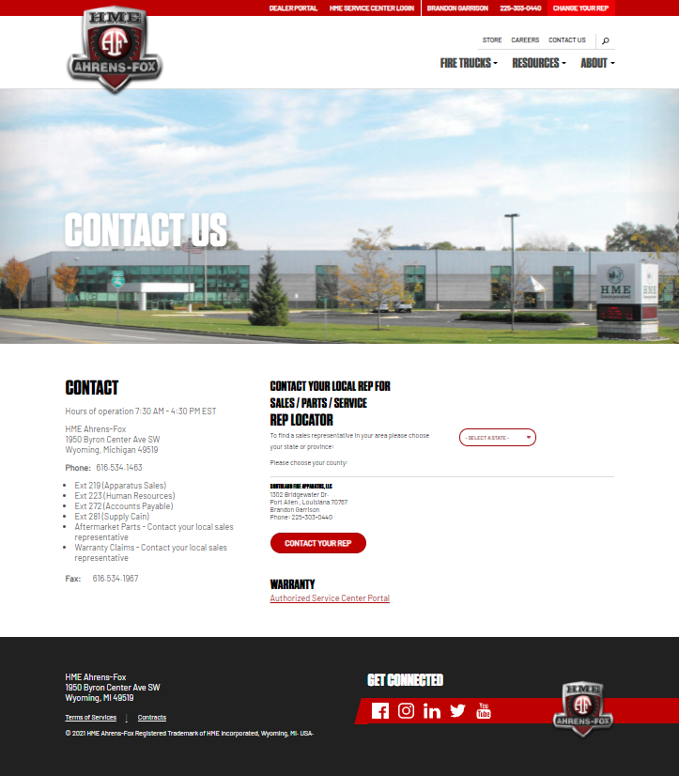
Enter the Authorized Service Center Portal

Slide 3
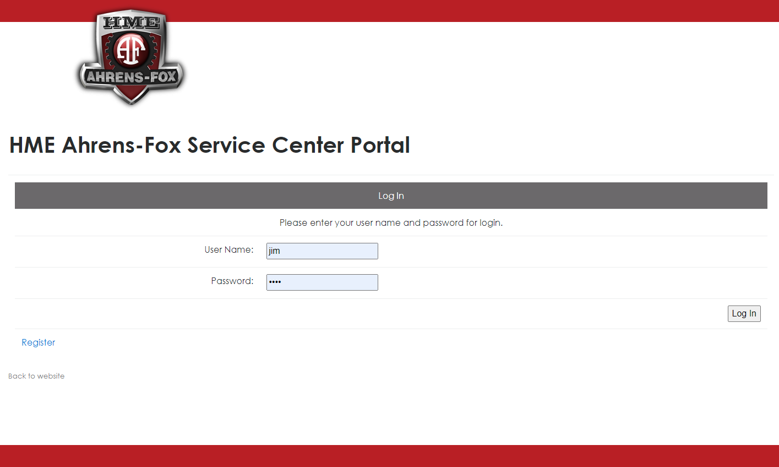
Add your username and password

Slide 4
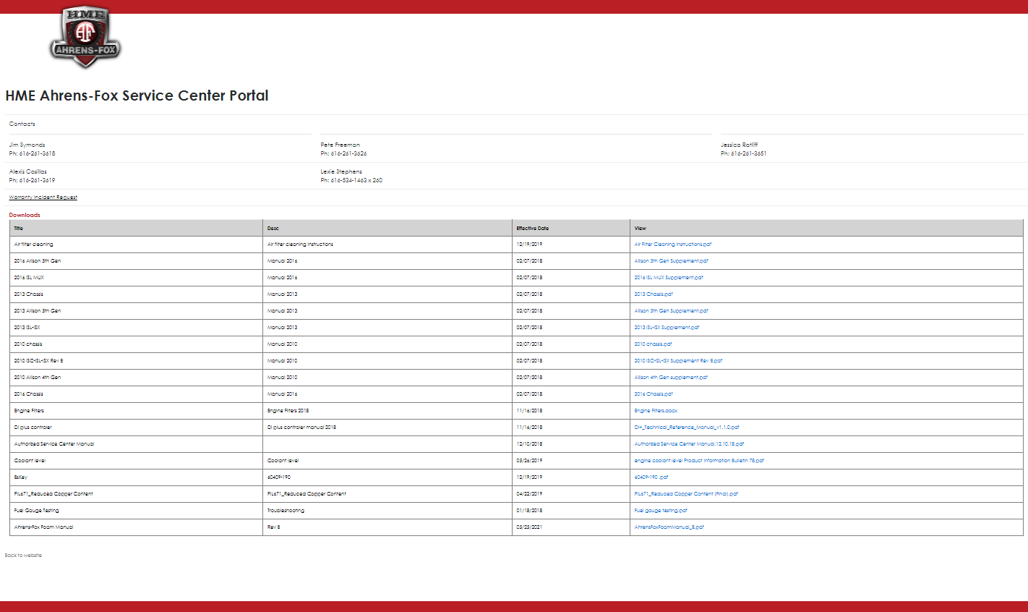
This will state Warranty Repair Order Request. Click here

Slide 5
This wording will change
To add an RO

Slide 7
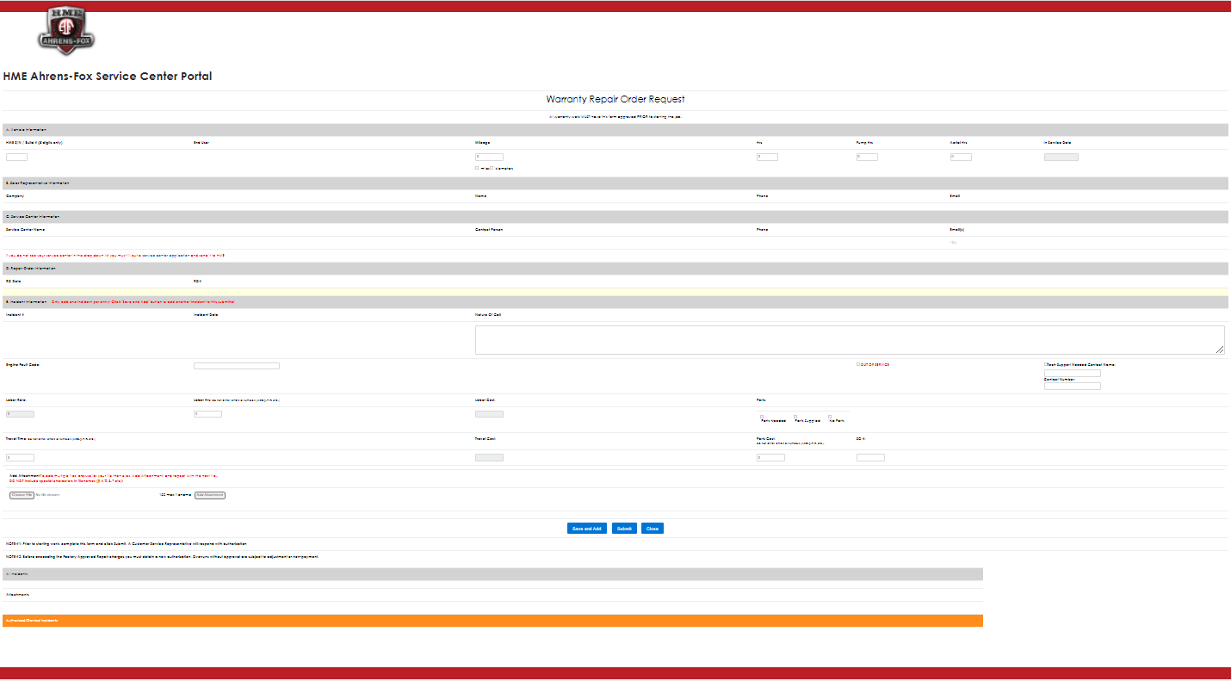
When there is one issue then use submit
If there are more than one issue use save and add then use submit to enter the last issue.
This will generate an RO and one incident per issue.
All incidents can be modified until they are authorized

Slide 8
The open RO can be added to by entering an incident into the RO until all the incidents in the RO are closed.
At that time, the RO is closed.

Slide 9
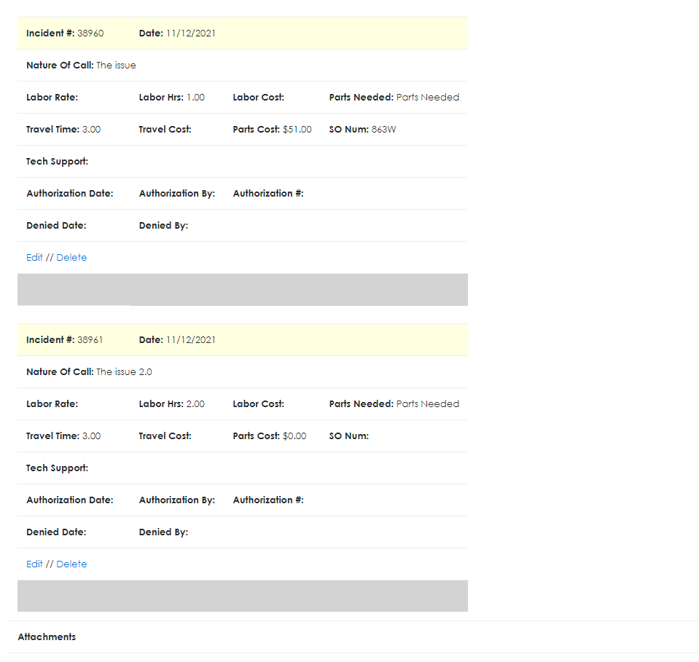
Having the Incidents under an RO will keep all the incidents for one issue in one place

Slide 10
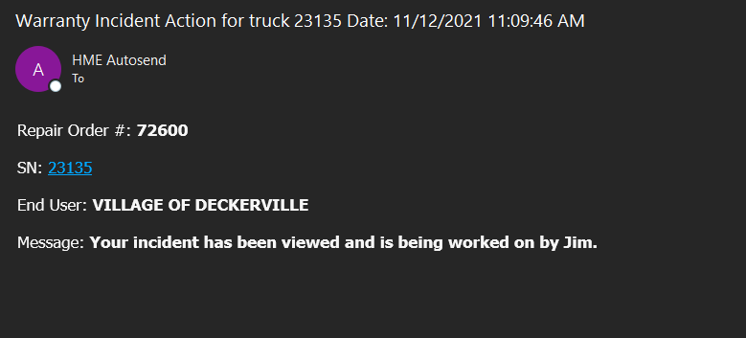
Email notification that your Repair Order is being worked on and by who.

Slide 11
Invoicing can be as simple as
Truck # 23135 Invoice#0001
RO #72600
Incident #38960------------$0.01
Incident #38961------------$0.01
Total --------------------------$0.02

Slide 12
Are there any questions?

